Slide 1
Back up
Required Materials for IHVs
Optional Materials for OEMs
Back up Presentation

Slide 2
Responsibilities of Driver Writer
Driver Image Handle Required Protocols
Driver Image Handle
EFI_LOADED_IMAGE_PROTOCOL
Installed by the core
Published by the driver
Unload()
EFI_DRIVER_BINDING_PROTOCOL
    Supported()
    Start()
    Stop()
    Version
Installed by the driver
Notes:
2d style blocks so that they are all in the box.

Slide 3
More
Responsibilities of Driver Writer
Driver Image Handle Optional Protocols
  Required for DIG64 (Itanium® architecture)
Driver Image Handle
EFI_DRIVER_CONFIGURATION_PROTOCOL
SetOptions()
OptionValid()
ForceDefaults()
SupportedLanguages
EFI_DRIVER_DIAGNOSTICS_PROTOCOL
    RunDiagnostics()
    SupportedLanguages
EFI_COMPONENT_NAME_PROTOCOL
GetDriverName()
GetControllerName()
SupportedLanguages
Notes:
2d style blocks so that they are all in the box.

Slide 4
PCI Controller Device Handle
Supported()
  Checks to see if a driver supports a controller
  Check should not change hardware state of controller
  Minimize execution time, move complex I/O to Start()
  May be called for controller that is already managed
  Child is optionally specified
PCI Controller Device Handle
EFI_DEVICE_PATH_PROTOCOL
EFI_PCI_IO_PROTOCOL

Slide 5
PCI Controller Device Handle
Start()
  Opens PCI I/O
  Starts a driver on a controller
  Can create ALL child handles or ONE child handle
PCI Controller Device Handle
PCI Controller Device Handle
EFI_DEVICE_PATH_PROTOCOL
EFI_DEVICE_PATH_PROTOCOL
EFI_PCI_IO_PROTOCOL
EFI_PCI_IO_PROTOCOL
EFI_BLOCK_IO_PROTOCOL

Slide 6
PCI Controller Device Handle
Stop()
  Closes PCI I/O
  Stops a driver from managing a controller
  Destroys all specified child handles
  If no children specified, controller is stopped
  Stopping a bus controller requires 2 calls
PCI Controller Device Handle
PCI Controller Device Handle
EFI_DEVICE_PATH_PROTOCOL
EFI_DEVICE_PATH_PROTOCOL
EFI_PCI_IO_PROTOCOL
EFI_PCI_IO_PROTOCOL
EFI_BLOCK_IO_PROTOCOL

Slide 7
Driver Objects
Handles
  Collection of one or more protocols
  Stored in the handle database
  Represents
    Executable images such as EFI drivers and EFI applications
    Protocols
    Devices such as network controllers and hard drive partitions
    EFI Services such as EFI Decompression and the EFI Byte Code (EBC) Virtual Machine
Protocols
  Block of function pointers and data structures or APIs
  Named by GUIDs

Slide 8
Source File Recommendations
Driver.c
DriverEntryPoint()
Unload()
NotifyExitBootServices()
NotifySetVirtualAddressMap()
Supported()
Start()
Stop()
Produced Protocol Functions
ComponentName.c
GetDriverName()
GetControllerName()
DriverConfiguration.c
SetOptions()
OptionsValid()
ForceDefaults()
DriverDiagnostics.c
Private Context Structure
Global Variable Declarations
Function Prototypes
RunDiagnostics()
Source Files
Libraries
Driver Entry Point
BootService or Runtime Driver
Driver.h
Make.inf

Slide 9
Source File Recommendations
Driver.c
Low Complexity Drivers
  4 Functions
  1 Data Structure Designed
Medium Complexity Drivers
  7 Functions
  1 Data Structure Designed
High Complexity Drivers
  14 Functions
  1 Data Structure
Very High Complexity Drivers
  20+ Functions
  3+ Data Structures Designed
ComponentName.c
DriverConfiguration.c
DriverDiagnostics.c
Driver.h
Make.inf

Slide 10
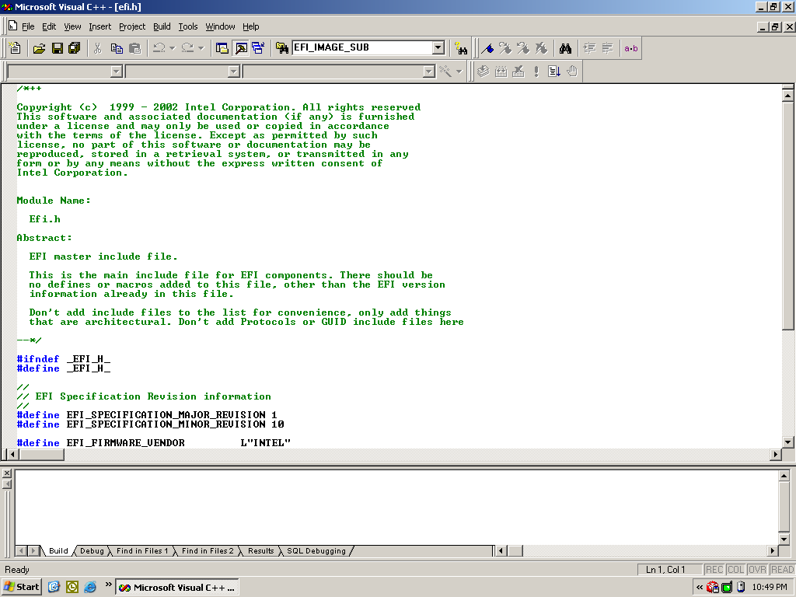
Driver Source Code Examples
Notes:
Create a directory in \Edk\Drivers
Add Files to directory
Show Driver Entry Point with various additional features.
Show Private Context Data Structure
Show This Pointer and CR() Macro
Show the Driver Binding Protocol
Show Component Name Protocol
Add a Make.Inf file (Show Contents)
Build the driver
Load the driver in the NT32 env
Show the driver’s functionality

Slide 11
Driver Implementation Steps
Create Directory
Design Private Context Data Structure
Add Source Files to Directory
Add Make.inf File to Directory
Update Master Makefile
Build Driver
Good Designs Save Time and Money

Slide 12
Testing Driver Functions
Driver.c
DriverEntryPoint()
Unload()
NotifyExitBootServices()
NotifySetVirtualAddressMap()
Supported()
Start()
Stop()
Produced Protocol Functions
ComponentName.c
DriverConfiguration.c
DriverDiagnostics.c
Shell> Load –nc DriverName.efi

Slide 13
Testing Driver Functions
Driver.c
DriverEntryPoint()
Unload()
NotifyExitBootServices()
NotifySetVirtualAddressMap()
Supported()
Start()
Stop()
Produced Protocol Functions
ComponentName.c
DriverConfiguration.c
DriverDiagnostics.c
Shell> Load DriverName.efi

Slide 14
Testing Driver Functions
Driver.c
DriverEntryPoint()
Unload()
NotifyExitBootServices()
NotifySetVirtualAddressMap()
Supported()
Start()
Stop()
Produced Protocol Functions
ComponentName.c
DriverConfiguration.c
DriverDiagnostics.c
Shell> Unload DriverHandle

Slide 15
Testing Driver Functions
Driver.c
DriverEntryPoint()
Unload()
NotifyExitBootServices()
NotifySetVirtualAddressMap()
Supported()
Start()
Stop()
Produced Protocol Functions
ComponentName.c
DriverConfiguration.c
DriverDiagnostics.c
Install and Boot an EFI Compliant Operating System

Slide 16
Testing Driver Functions
Driver.c
DriverEntryPoint()
Unload()
NotifyExitBootServices()
NotifySetVirtualAddressMap()
Supported()
Start()
Stop()
Produced Protocol Functions
ComponentName.c
DriverConfiguration.c
DriverDiagnostics.c
Shell> Connect DeviceHandle DriverHandle

Slide 17
Testing Driver Functions
Driver.c
DriverEntryPoint()
Unload()
NotifyExitBootServices()
NotifySetVirtualAddressMap()
Supported()
Start()
Stop()
Produced Protocol Functions
ComponentName.c
DriverConfiguration.c
DriverDiagnostics.c
Shell> Disconnect DeviceHandle

Slide 18
Testing Driver Functions
Driver.c
DriverEntryPoint()
Unload()
NotifyExitBootServices()
NotifySetVirtualAddressMap()
Supported()
Start()
Stop()
Produced Protocol Functions
ComponentName.c
DriverConfiguration.c
DriverDiagnostics.c
Shell> Reconnect DeviceHandle
Shell> Reconnect -r

Slide 19
Testing Driver Functions
Driver.c
DriverEntryPoint()
Unload()
NotifyExitBootServices()
NotifySetVirtualAddressMap()
Supported()
Start()
Stop()
Produced Protocol Functions
ComponentName.c
DriverConfiguration.c
DriverDiagnostics.c
Tests Differ Based on Protocol
Notes:
Block I/O – DBLK and File Commands
Simple Input – Keyboard input in shell and EDIT
Simple Pointer – EDIT and HEXEDIT
Simple Text Output – Console Operations and BoxDraw
UGA Draw – Console Operations, BoxDraw, Blt
UNDI – PXE Boot from Boot Manager, TCP/IP stack
USB Host Controller – Test USB peripherals
Serial I/O – Serial Terminal Console
Load File – Boot Manager

Slide 20
Testing Driver Functions
Driver.c
ComponentName.c
GetDriverName()
GetControllerName()
DriverConfiguration.c
DriverDiagnostics.c
Shell> dh –d DriverHandle
Shell> Drivers

Slide 21
Testing Driver Functions
Driver.c
ComponentName.c
GetDriverName()
GetControllerName()
DriverConfiguration.c
DriverDiagnostics.c
Shell> dh –d DeviceHandle
Shell> Devices
Shell> DevTree

Slide 22
Testing Driver Functions
Driver.c
ComponentName.c
DriverConfiguration.c
SetOptions()
OptionsValid()
ForceDefaults()
DriverDiagnostics.c
Shell> DrvCfg –s DriverHandle DeviceHandle
Shell> DrvCfg –v DriverHandle DeviceHandle
Shell> DrvCfg –f DriverHandle DeviceHandle
Shell> DrvCfg –s DrvHndl DevHndl ChildHndl

Slide 23
Testing Driver Functions
Driver.c
ComponentName.c
DriverConfiguration.c
DriverDiagnostics.c
RunDiagnostics()
Shell> DrvDiag –s DriverHandle DeviceHandle
Shell> DrvDiag –e DriverHandle DeviceHandle
Shell> DrvDiag –m DriverHandle DeviceHandle

Slide 24
Checking For Load / Unload Leaks
gBS->AllocatePool() / gBS->FreePool()
gBS->AllocatePages() / gBS->FreePages()
gBS->InstallMultipleProtocolInterfaces()
gBS->UninstallMultipleProtocolInterfaces()
Shell> Memmap
Shell> Dh
Shell> Load DriverName.efi
Shell> Memmap
Shell> Dh
Shell> Unload DriverHandle
Shell> Memmap
Shell> Dh

Slide 25
Checking For Memory Leaks
gBS->AllocatePool() / gBS->FreePool()
gBS->AllocatePages() / gBS->FreePages()
Shell> Memmap
Shell> Connect DeviceHandle DriverHandle
Shell> Memmap
Shell> Disconnect DeviceHandle DriverHandle
Shell> Memmap
Shell> Reconnect DeviceHandle
Shell> Memmap

Slide 26
Checking For Handle Leaks
gBS->InstallMultipleProtocolInterfaces()
gBS->UninstallMultipleProtocolInterfaces()
Shell> dh
Shell> Connect DeviceHandle DriverHandle
Shell> dh
Shell> Disconnect DeviceHandle DriverHandle
Shell> dh
Shell> Reconnect DeviceHandle
Shell> dh

Slide 27
Checking For Protocol Leaks
gBS->OpenProtocol() / gBS->CloseProtocol()
Shell> OpenInfo DeviceHandle
Shell> Connect DeviceHandle DriverHandle
Shell> OpenInfo DeviceHandle
Shell> Disconnect DeviceHandle DriverHandle
Shell> OpenInfo DeviceHandle
Shell> Reconnect DeviceHandle
Shell> OpenInfo DeviceHandle

Slide 28
Debug Macros
ASSERT (Expression)
  If Expression is FALSE, then print file name and line number and halt.
ASSERT_EFI_ERROR (Status)
  If Status is not EFI_SUCCESS, then print file name and line number and halt.
CR (Record, Type, Field, Signature)
  ASSERT()s if Data Structure Signature does not match
EFI_BREAKPOINT ()
  Generate a CPU break point instruction
Notes:
Show ERR ErrorLevel command for DEBUG() macros

Slide 29
Debug Macros
DEBUG (ErrorLevel, String, …)
  Print String if ErrorLevel is active.
Shell> Err ErrorLevel
EFI_D_ERROR 0x80000000
EFI_D_INIT 0x00000001
EFI_D_WARN 0x00000002
EFI_D_INFO 0x00000040
EFI_D_BLKIO 0x00001000
EFI_D_UNDI 0x00010000
Notes:
Show ERR ErrorLevel command for DEBUG() macros

Slide 30

When DEBUG() is not Available
POST Card (I/O 0x80)
  PCI Root Bridge I/O Protocol
  PCI I/O Protocol
Value = 0x03;
Status = PciIo->Io.Write (
PciIo, // This
EfiPciIoWidthUint8, // Width
EFI_PCI_IO_PASS_THROUGH_BAR, // BAR
0x80, // Offset
1, // Count
&Value // Buffer
);
May not work on all platforms
May produce unpredictable results
Must be removed from production drivers

Slide 31
When DEBUG() is not Available
UART (COM1 I/O 0x3F8-0x3FF)
UART (Platform Specific MMIO)
  PCI Root Bridge I/O Protocol
  PCI I/O Protocol
Hello World
Check Point 1
Check Point 2
Check Point 3
Status = PciIo->PollIo (PciIo, EfiPciIoWidthUint8,
EFI_PCI_IO_PASS_THROUGH_BAR,
0x3FD, 0x20, 0x20, 1000000, &Lsr);
Status = PciIo->Io.Write (PciIo, EfiPciIoWidthUint8,
EFI_PCI_IO_PASS_THROUGH_BAR,
0x3F8, 1, &Data);
May not work on all platforms
May produce unpredictable results
Must be removed from production drivers

Slide 32
When DEBUG() is not Available
VGA (MMIO 0xB8000-0xBFFFF)
  PCI Root Bridge I/O Protocol
  PCI I/O Protocol
Hello_World
Check_Point_1
Check_Point_2
Check_Point_3
VideoAddress = 0xB8000 + (Row * 80 + Column) * 2;
VideoCharacter = 0x0700 | Character;
Status = PciIo->Mem.Write (PciIo, EfiPciIoWidthUint16,
EFI_PCI_IO_PASS_THROUGH_BAR,
VideoAddress, 1, &VideoCharacter);
May not work on all platforms
May produce unpredictable results
Must be removed from production drivers

